Slide 1

Biometrics 101
Mr. Benji Hutchinson
MorphoTrust USA
Senior Director, Federal Business
703-508-3864
jbhutchinson@morphotrust.com
Presented by
The International Biometrics & Identification Association (IBIA)

Slide 2
Who are we? What do we do?
The International Biometrics & Identification Association (IBIA) advances the adoption and responsible use of technologies for managing human identity to enhance security, privacy, productivity, and convenience for individuals, organizations, and governments.
To effectively carry out its mission, IBIA focuses on three core activities: Advocacy, Connections and Education.
https://www.ibia.org

Slide 3
Purpose of this Talk
To provide an overview of biometrics technology and use cases to the audience of the Global Identity Summit
To summarize major business trends in the biometrics industry
To highlight examples of mass consumer adoption and commercialization of biometrics
To discuss privacy concerns and cyber threats related to biometric data

Slide 4
Biometrics 101
What are biometrics?
How does this technology work?
How is biometric technology used?
Where is biometric technology heading?
What are the major business trends within the industry of biometrics?
What affect will broader technology trends have on biometrics?

Slide 5
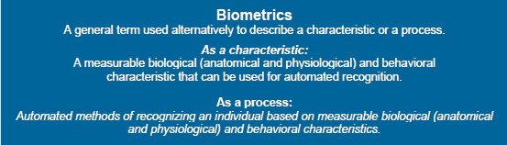
Biometrics: A Definition

Slide 6
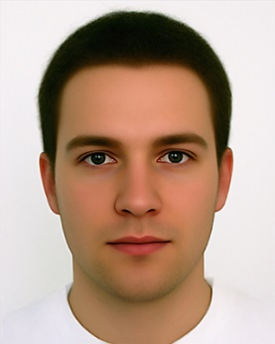
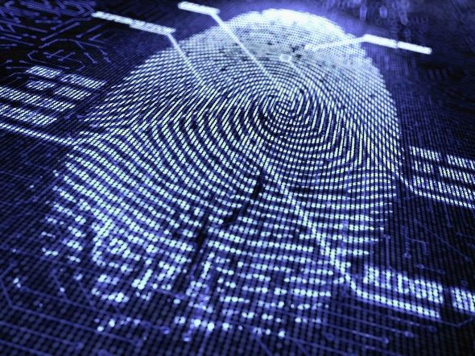
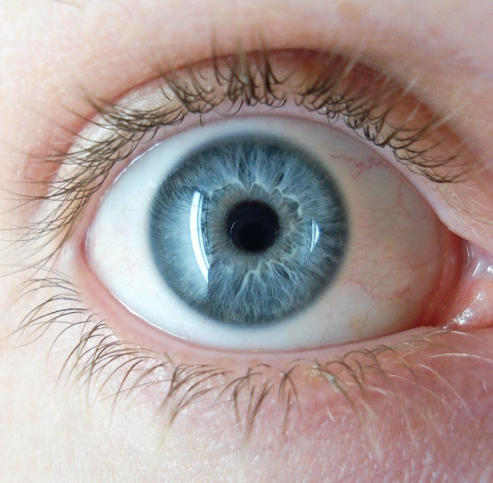
Biometric Modalities
Fingerprints
Face
Iris
Speech (Voice)
DNA

Slide 7
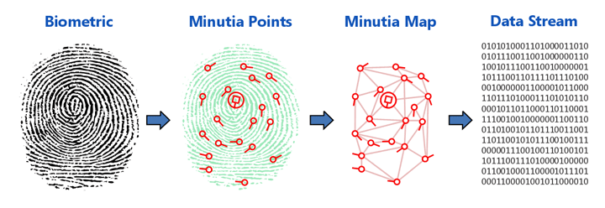
Fingerprints (Friction Ridges)

Slide 8
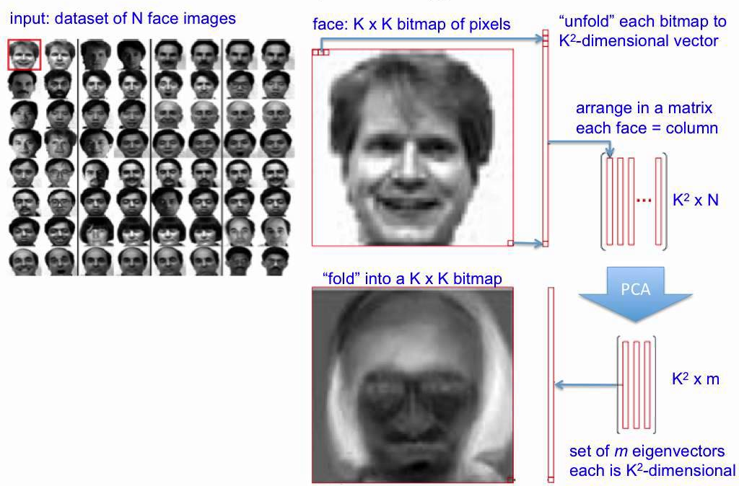
Face
Notes:
Emphasize this is how it is done in PCA but there are plenty of other methods

Slide 9
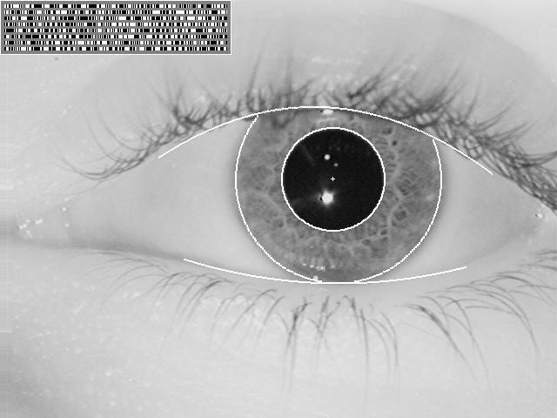
Iris
Notes:
Segment
Unwrap
Binarize
Discuss binary template and hamming distance. This is done in IR not visible light.
Barring disease, the iris is stable for a persons lifetime
A well protected exposed organ
Feature rich
THE IRIS IS NOT THE RETINA! That is a biometric but rarely used in the states except to track cows.
Uses a monochromatic image sensor
Custom optimized optical path
Very low power multi-band NIR illumination
Visible light extracted from the image capture process
Creates a template from the iris – not the retina !
Image is ANSI/ISO standards based
Templates are proprietary

Slide 10
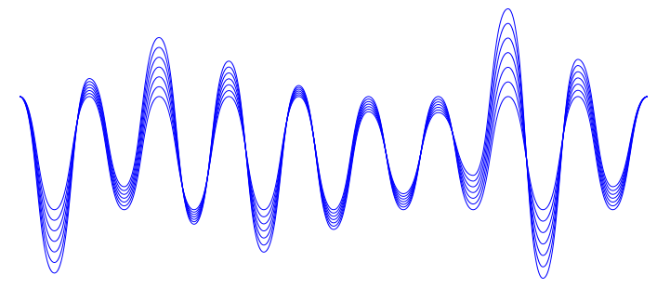
Voice

Slide 11
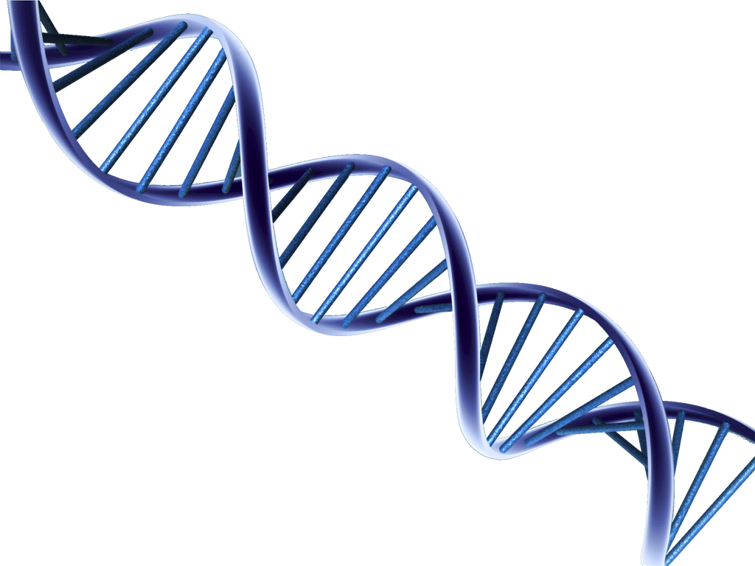
DNA
Notes:
3 Minutes Hands-On Results in ~ 90 minutes Increased Assurance
Rapid DNA analysis is a hands-free and automated process that develops a CODIS-compatible profile from a reference sample in less than two hours.
“Swab in – profile out” process automates extraction, amplification, separation, detection and allele identification, without human intervention.
Benefits of Rapid DNA:
No opportunity for sample switch or contamination
Portable
No human intervention
No special training or education requirements
Results in less than 2 hours
No laboratory required

Slide 12



Three Basic Functions
Enroll
Verify 1:1
Identify 1:N
12
Notes:
Enrollment
Adding biometric information to a data file
Can include screening for duplicates in database (repository)
Repository
Place to store enrolled biometric templates (for later comparison)
Should be protected (secure area, signed/encrypted, etc.)
Discuss the capture device
Verification (one-to-one – 1:1)
Matching against a single record
Answers “Is this person who they claim to be?”
Algorithms
Processing (feature extraction)
Matching
Identification (one-to-many, or “one to N” – 1:N)
Matching against all records in the database
Answers “Do we have a record of this person?”

Slide 13

Template Generation
13
Notes:
Capture
Measure biometric characteristic using a sensing device
Data may be a bitmapped image, audio stream, etc.
A series of samples may be captured
Sometimes includes a quality value
Process
Converting the data into a numeric identifier (template)
Generally involves “feature extraction”, but can also include other manipulations

Slide 14
Example of Fingerprint Template
Y
Ridge
Branches
Ridge
Endings
X
Image
Template
14

Slide 15
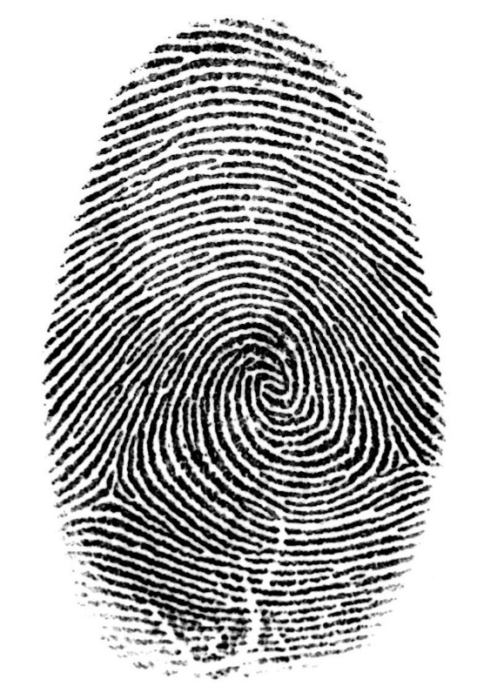

Searching and Matching
15
Notes:
Match
Comparing a processed biometric template to a previously enrolled biometric template(s) to determine level of similarity
Many methods (types of algorithms) used
Output of match process is a score
Probability of match (i.e., belonging to the same subject)
Decision
Determination of match results
Match results compared against a threshold score
Above threshold = Match
Below threshold = No-match

Slide 16
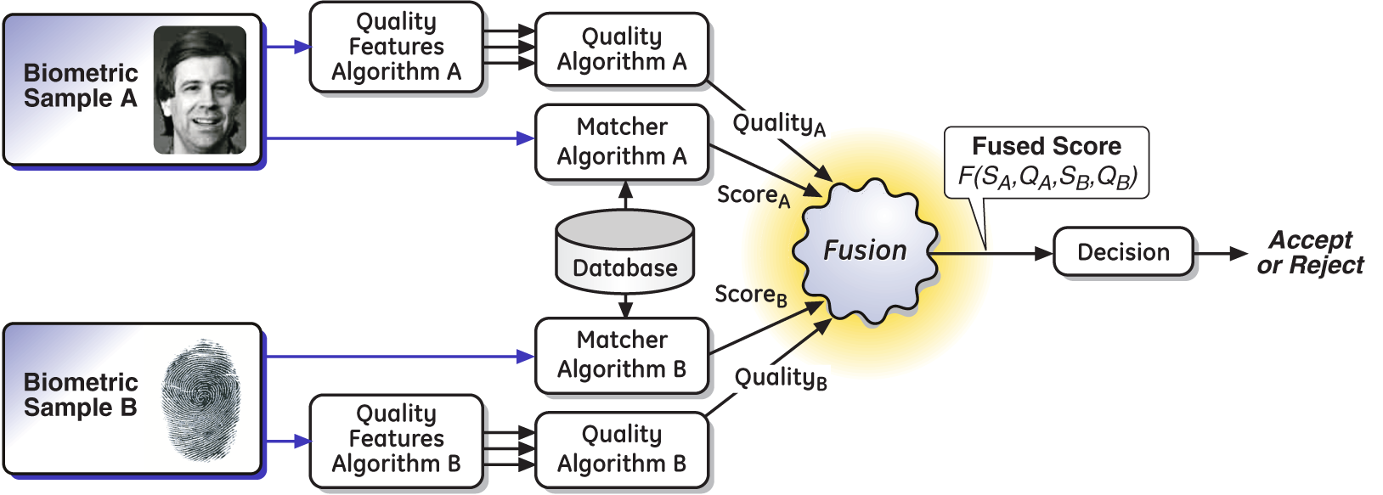
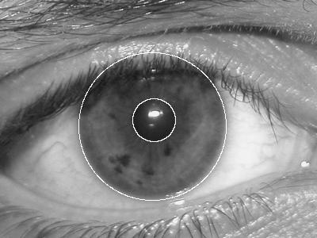
Fusion
16
Notes:
This ROC curve is improved by the fusion of (for example) both face and iris biometrics. Speed of match can be enhanced as well.
The source of the data shown is December 2008 from the NIST Multiple Biometric Grand Challenge (MBGC) submission from LM (quality-based Bayesian fusion algorithm) with IriTech (iris algorithm) and Cognitec (face algorithm).

Slide 17
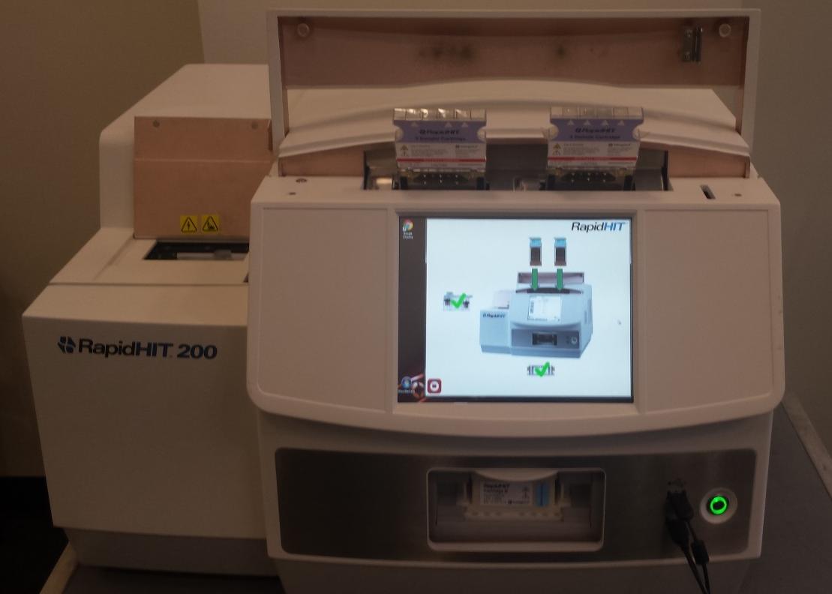
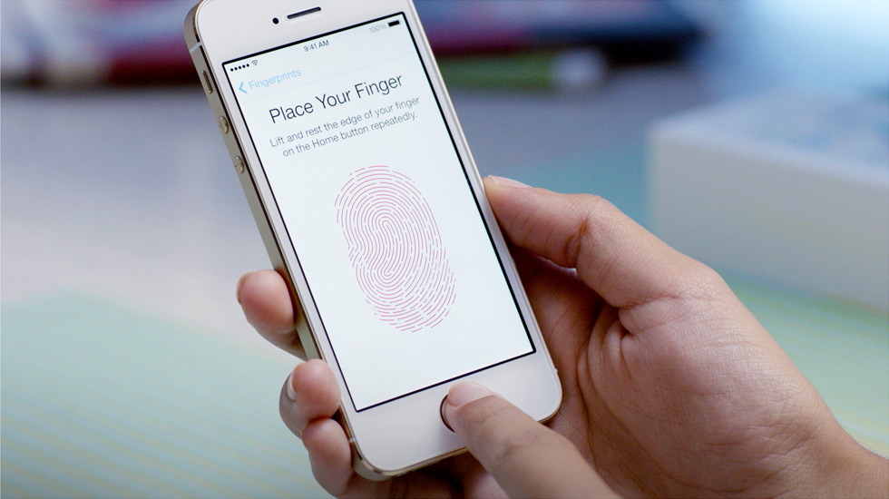
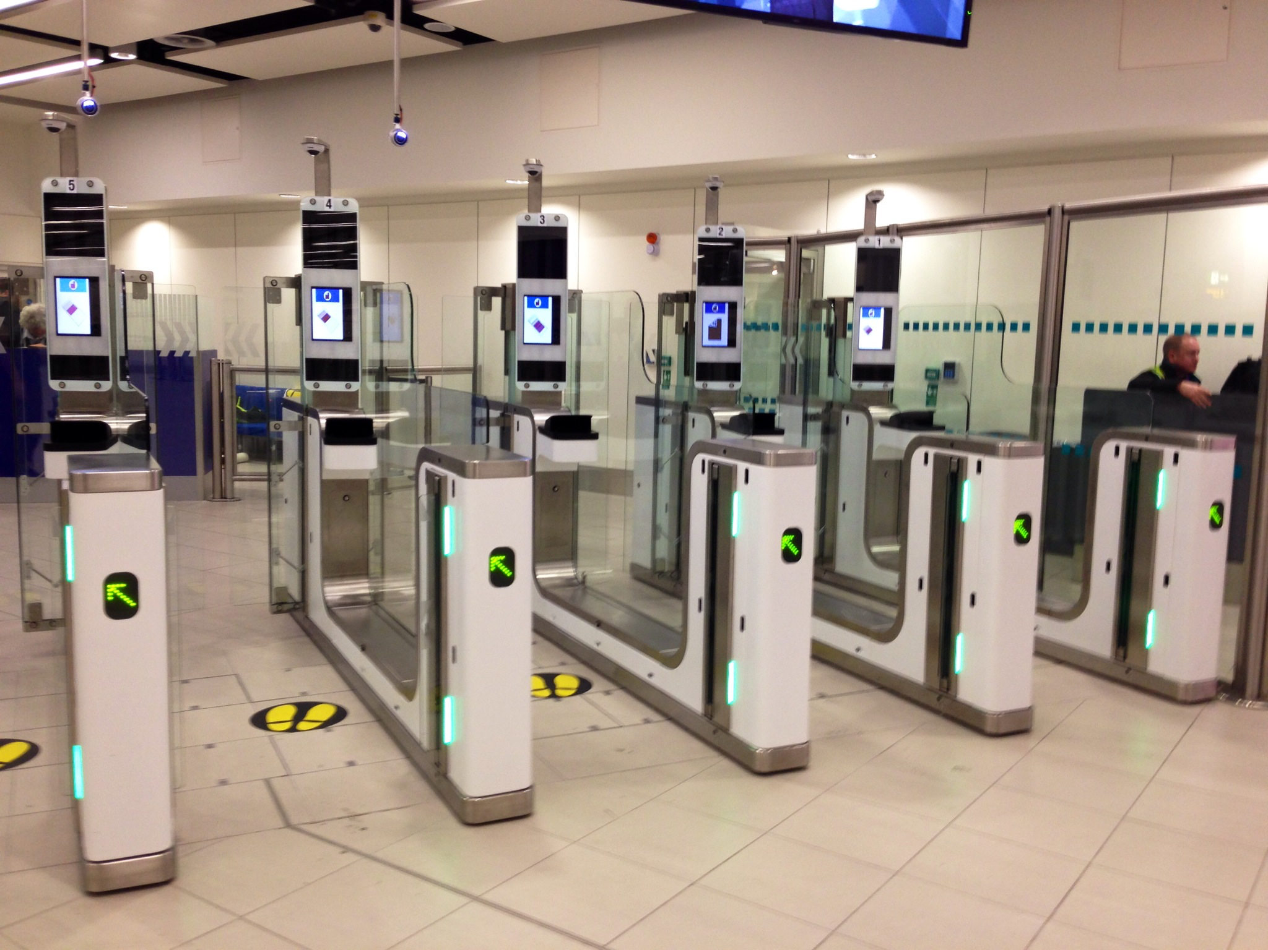
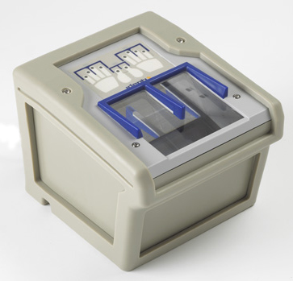
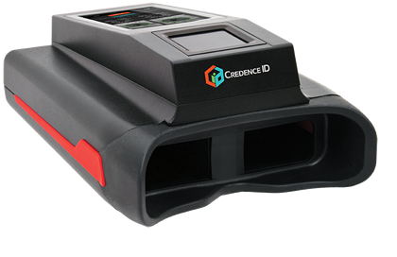
Examples of Biometric Technology
Each run requires 2 sample cartridges
and 2 reagent cartridges.
17
Notes:
3 Minutes Hands-On Results in ~ 90 minutes Increased Assurance
Rapid DNA analysis is a hands-free and automated process that develops a CODIS-compatible profile from a reference sample in less than two hours.
“Swab in – profile out” process automates extraction, amplification, separation, detection and allele identification, without human intervention.
Benefits of Rapid DNA:
No opportunity for sample switch or contamination
Portable
No human intervention
No special training or education requirements
Results in less than 2 hours
No laboratory required

Slide 18
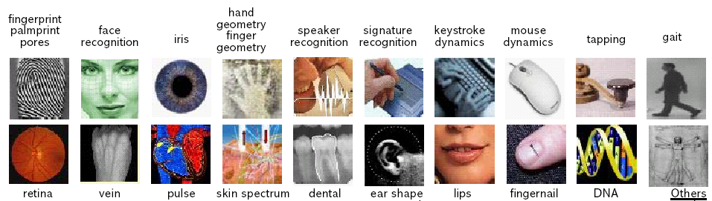
Applications of Biometrics
NGI / TWIC /
USVISIT /
DoS / DoD
Border / Immigration
Finance Industry
Intel / SIGINT
Intel / Defense / HLS
smell
Access Control
(rare)
Private Uses
Checkpoints
Forensics
LE / Defense / Intel / HLS / Forensics
LE/ Defense / HLS
Notes:
Commercial
Access to facilities and information systems
Employee timekeeping
Healthcare identification and financial transactions
National Strategy for Secure Transactions in Cyberspace
Law enforcement
Investigations, background checks
Forensic analysis
Civil systems
Border and immigration control
Entitlement benefit eligibility screening and verification
Defense and Intelligence
Identifying Blue Force (our people), Red Force (the enemy), and Gray Force (the unknown local populace)
Forensic analysis

Slide 19



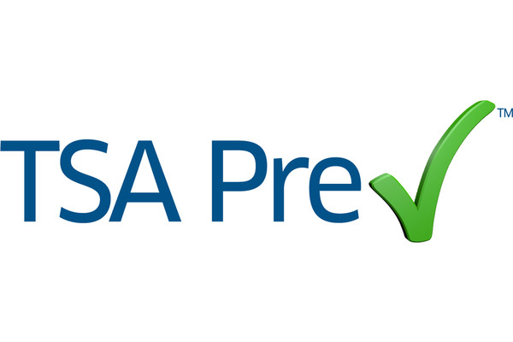

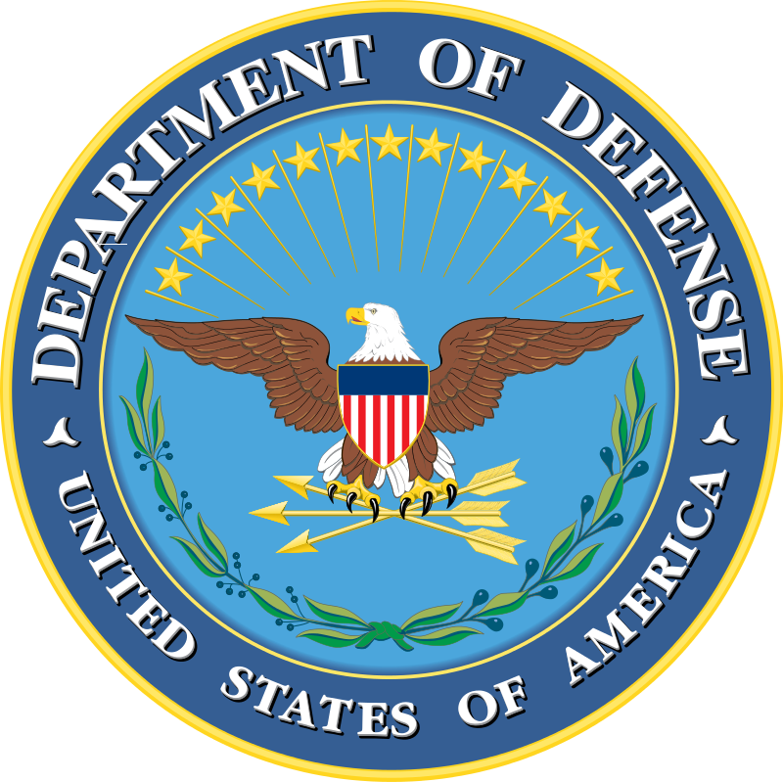

Large Scale Federal Government Biometrics Related Programs
IDENT
BioVISA
Passports
TIDE
NGI
ABIS
19

Slide 20
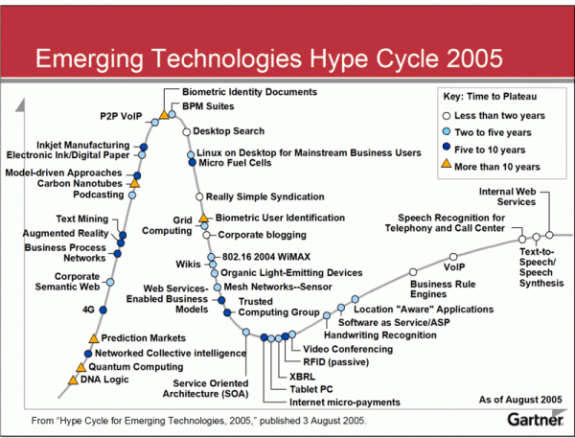
Back to the Future
20
Notes:
Before we can fully answer this question, it’s important to take a step back to understand the legacy so that we fully understand where this is all heading.
September 11th 2001 was a potent catalyst for hyping the capabilities of digital identity technologies, particularly biometrics.
National Security spending on biometrics technology during the Iraq and Afghanistan wars stimulated a massive multi-mullion dollar industry that was already growing.
This is what it looked like in 2005. How many of you are familiar with the Gartner hype cycle for technology? Notice the red arrows.
This is the same era where we saw linkages being draw between digital biometrics and physical tokens or security credentials such as passports and driver’s licenses.
This was the full hype era of biometrics. It spawned growth in my company, then known as L-1 Identity Solutions.
PAUSE FOR JOKE - I remember hearing quotes at trade shows during this period proclaiming this was the year of biometrics – in 2008!!

Slide 21
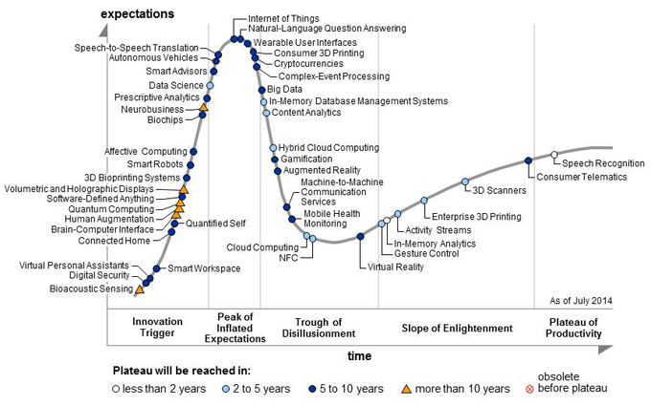
Where did biometric technology go in 2015?
21
Notes:
Ten years on…
As of July 2014 and no doubt in the 2015 Gartner Hype Cycle, identity related technologies such as biometrics do not appear. Why not? They have matured and moved into the “Plateau of Productivity”.
Economic conditions have changed as globalization deepens. Hardware sensors for identity technology have becoming increasingly commoditized as more and more production has been shifted to Asia, where labor rates are cheaper than in Western developed countries. Software for identity solutions retains much of its previous value but it is becoming more commoditized as more players enter the marketplace. This introduces competitive pressures in the innovation of products and price changes. Most folks in this room have heard this narrative.
Does it fully explain what happened? No…

Slide 22

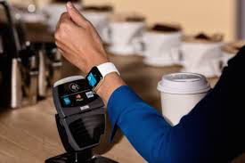




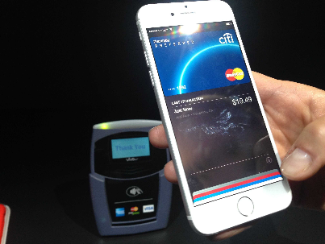



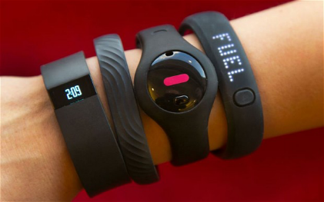


Private and Commercial Sectors Take Interest
Electronic Payments
Cyber/Big Data Breaches
Cloud
Mobility
22
Notes:
DISRUPTION! The multi-million dollar industry mushroomed into a multi-billion dollar industry when the commercial and private sectors became interested in this technology. Apple being the most visible as of late. But these technologies are proliferating in various ways that connect to tradition identity technologies.
These four trends explain a significant portion of the recent interest in identity related technology – more often included in multi-factor authentication solutions.

Slide 23
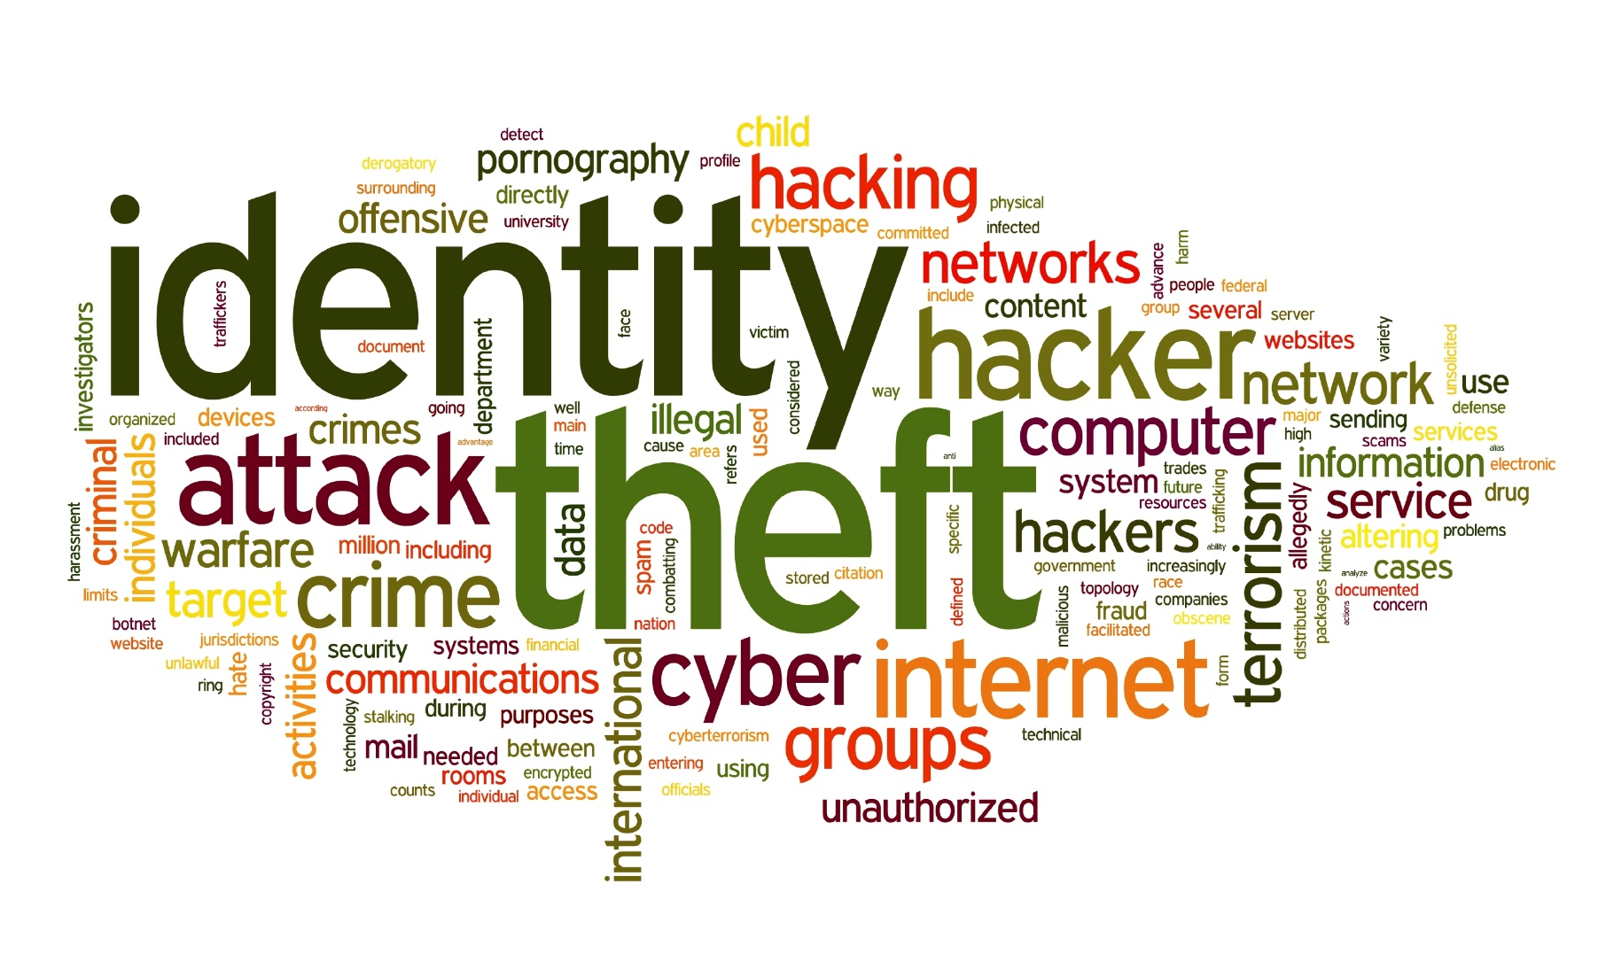
Benefits of Biometrics: Security and Convenience in Cyber Space
23
Notes:
Biometrics link an event to a particular individual - not just to a password or token
Convenient – nothing to remember
Can’t be guessed, stolen, shared, lost, or forgotten
Prevents impersonation
Protects against identity theft
Higher degree of non-repudiation
Enhances privacy
Protects against unauthorized access to personal information
Complementary with other authentication mechanisms
Smart cards
Public Key Infrastructure
PIN codes
Security tokens

Slide 24
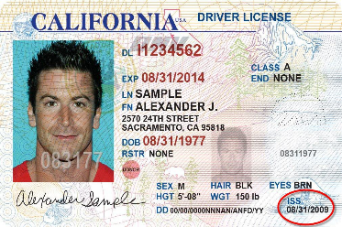
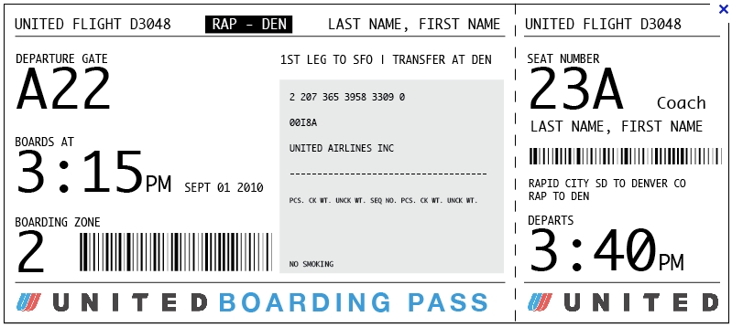
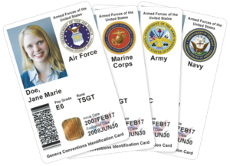
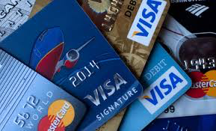

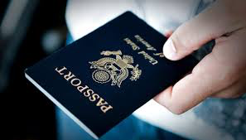
The Challenge:
Physical and Digital Convergence
Gone Digital!
Going Digital?
Secure?
Trustworthy?
Simple?
24
Notes:
Various identity technologies are going from physical to digital formats. From paper tickets, boarding passes, to credit cards – all these tokens are going digital. Will the secure credentials or tokens we use in every day life also go digital? What challenges do we face as that occurs? Right off the bat we need to determine if these emerging solutions will be secure, trustworthy, and simple to use. These characteristics will drive adoption among users and consumers.
But how do we manage the the effects of this convergence at the intersection of government benefits or national security operations that traditionally depend on physical identity technologies?

Slide 25
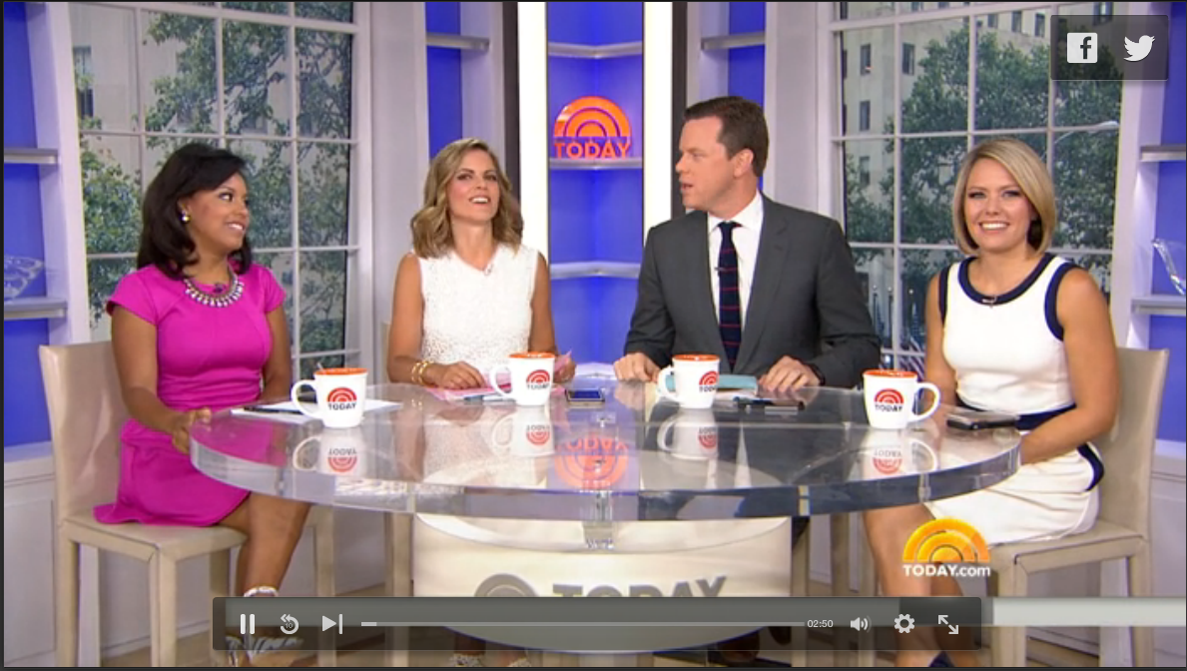
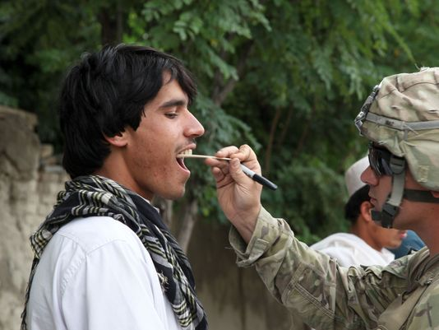
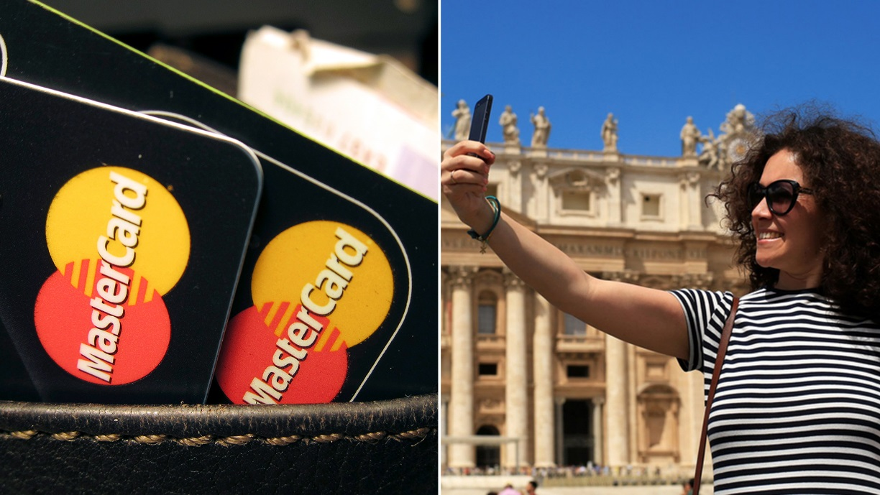
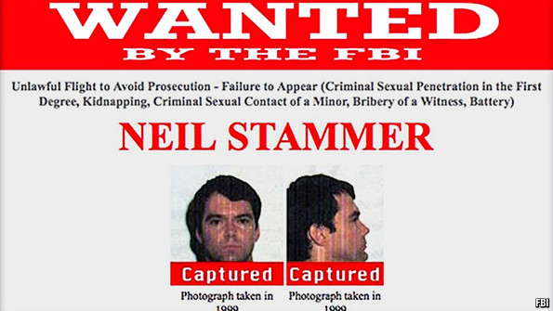
Biometrics in the News
NBC Today Show
Iowa Starts Offering Digital Driver’s Licenses
September 7, 2015
Defense News
US Special Operations Tests DNA Scanners
May 20, 2015
NBC Today Show
MasterCard to Allow Customers to Take a Selfie to Verify Online Payments
July 7, 2015
The Economist
Biometrics: Clocking People’s Clocks – Facial Recognition Systems are Getting Better
August 23, 2014
25

Slide 26

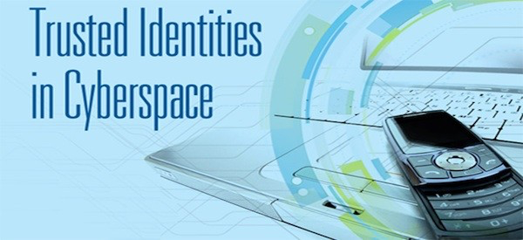

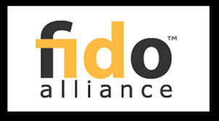


Biometrics Matures into Digital Identification Technology
®
26
Notes:
Major Trends that are closing the gap between public and private sector requirements for identity technology.
Secure transactions in cyber space
Access to benefits or services on the internet
Multi-factor authentication
Identity proofing and background checks for a wider range of careers, not just public sector or national security jobs
Fraud prevention and cost saving measures
These are just some of the value propositions and stakeholders who are embracing this convergence of the physical and digital worlds of identity technology.

Slide 27
Where is this heading?
DNA and Voice as biometric modalities will grow in importance over the next 5 years.
Digital identity related technology will continue to proliferate across both public and private sectors.
  Select secure government identity tokens and credentials will go digital (dDL in Iowa and Delaware).
  Private companies will accelerate adoption of multi-factor authentication technologies.
Persistent vetting and continuous evaluation will go mainstream.
End-to-end, fully integrated, secure, simple, and trustworthy identity technologies are most effective.
  Cyber transactions will increasingly include a trustworthy identity component.
Multi-modal biometric solutions will migrate to the cloud.
27

Slide 28
Thank you!
Questions?
Mr. Benji Hutchinson
MorphoTrust USA
Senior Director, Federal Business
703-508-3864
jbhutchinson@morphotrust.com
Presented by
The International Biometrics and Identification Association (IBIA)

